Slide 1
10-23 Weekly UA/UF
Sims
Investigating speedups in RX TTL program
DWS -> TTL first looks
Lab: Optical Truss Sideband Locking
Equipment from Han
Error signals/ loop closing estimates

Slide 2

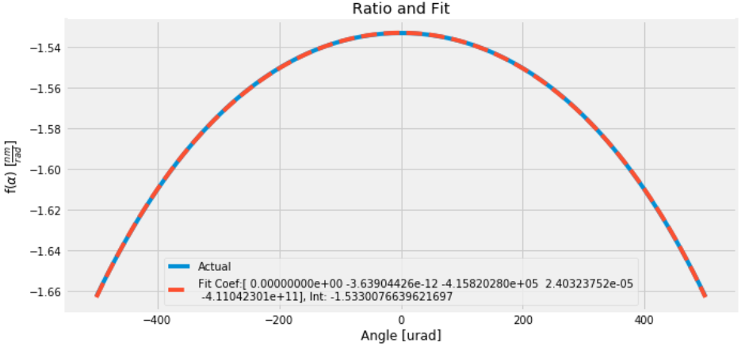
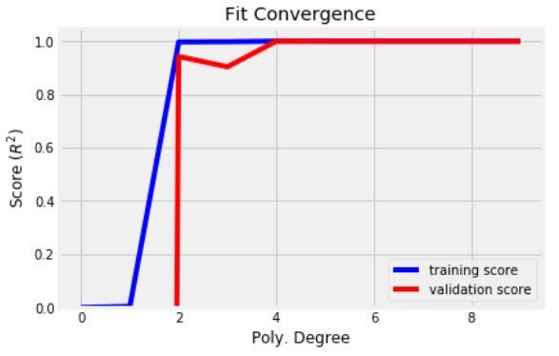
DWS as LPSR predictor
Some factor f, which may be function of tilt α, to return TTL from DWS
Fit shows f(α) matches well a fourth-order polynomial in α
To reasonable error, can f (α) be treated as constant
Given a range of simulation param’s & DWS data, can it be machine learned
LPSR/DWS

Slide 3
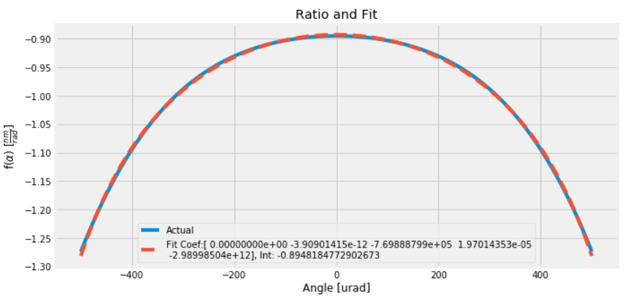
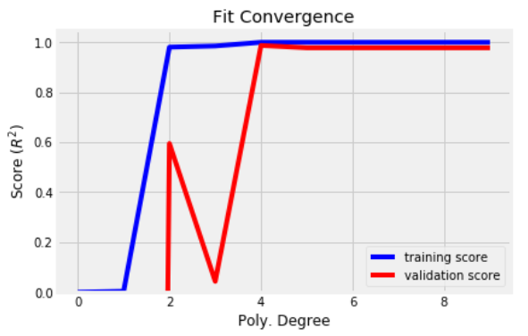
DWS as LPST predictor
LPST less “constant factor” than LPSR
LPST/DWS

Slide 4
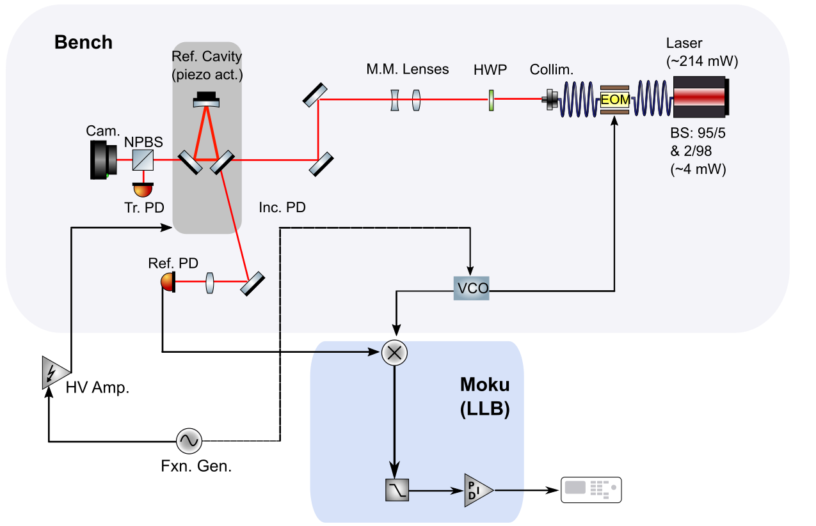
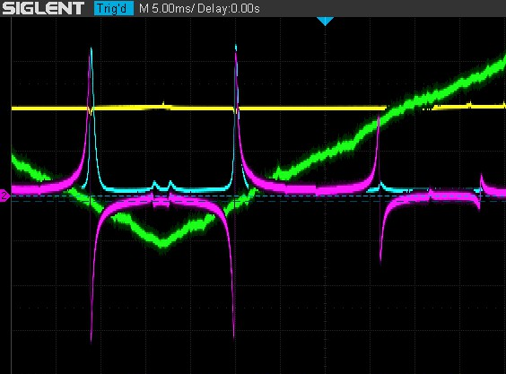
Optical Truss Sideband Locking

